Slide 1
Analysis of Algorithms Chapter 1.4

Slide 2
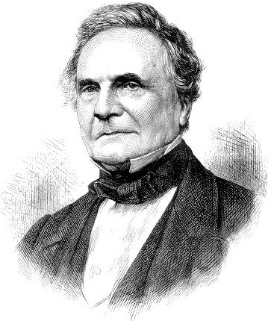
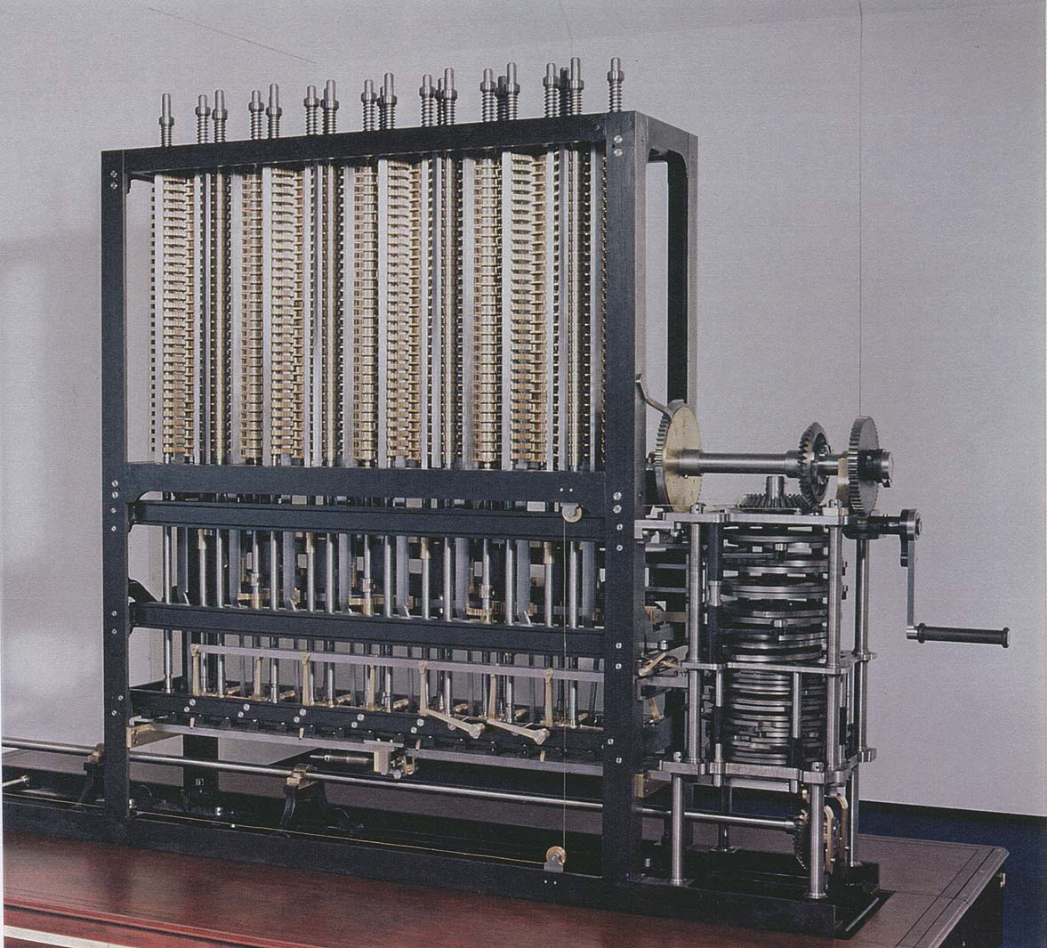
Running time
“ As soon as an Analytic Engine exists, it will necessarily guide the future course of the science. Whenever any result is sought by its aid, the question will arise—By what course of calculation can these results be arrived at by the machine in the shortest time? ” — Charles Babbage (1864)
how many times do you have to turn the crank?
Analytic Engine
Notes:
Babbage anticipated the importance of analyzing the efficiency of computer algorithms in the 1860s

Slide 3



Cast of characters
Programmer needs to develop
a working solution.
Student might play
any or all of these
roles someday.
Client wants to solve problem efficiently.
Theoretician wants
to understand.

Slide 4
Reasons to analyze algorithms
Predict performance.
Compare algorithms.
Provide guarantees.
Understand theoretical basis.
Primary practical reason: avoid performance bugs.
this course
theory of algorithms
client gets poor performance because programmer did not understand performance characteristics
Notes:
poor performance: today's lecture is about trying to avoid this

Slide 5
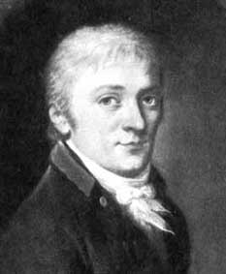
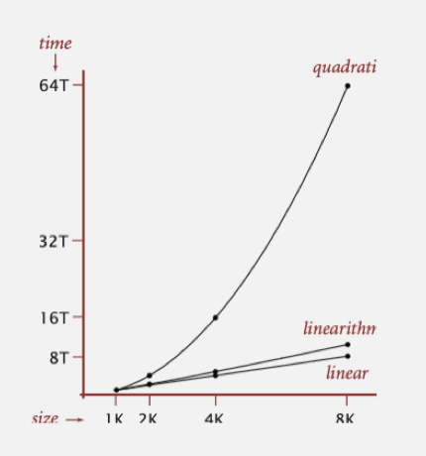
Some algorithmic successes
Discrete Fourier transform.
Break down waveform of N samples into periodic components.
Applications: DVD, JPEG, MRI, astrophysics, ….
Brute force: N ² steps.
FFT algorithm: N log N steps, enables new technology.
Friedrich Gauss
1805
quadratic
Notes:
[wayne] build N log N and plot
DFT = fast way to multiply two univariate polynomials
FFT reference: Runge-König (1924), Cooley-Tukey (1965) rediscovered FFT and popularized it. Discovered by Gauss at age of 28, two years before Fourier's paper on Fourier transforms!
astrophysicists want N = 64 gigapoints to search for pulsars; seismologists want N = 10 gigapoints to predict earthquakes

Slide 6

Some algorithmic successes
N-body simulation.
Simulate gravitational interactions among N bodies.
Brute force: N ² steps.
Barnes-Hut algorithm: N log N steps, enables new research.
Andrew Appel PU '81
quadratic
Notes:
Appel designed his fast multipole method for senior thesis in Physics at Princeton! (actually can be made linear)
physicists want N = # atoms in the universe

Slide 7
The challenge
Q. Will my program be able to solve a large practical input?
Insight. [Knuth 1970s] Use scientific method to understand performance.
Why is my program so slow ?
Why does it run out of memory ?

Slide 8

Scientific method applied to analysis of algorithms
A framework for predicting performance and comparing algorithms.
Scientific method.
Observe some feature of the natural world.
Hypothesize a model that is consistent with the observations.
Predict events using the hypothesis.
Verify the predictions by making further observations.
Validate by repeating until the hypothesis and observations agree.
Principles.
Experiments must be reproducible.
Hypotheses must be falsifiable.
Feature of the natural world. Computer itself.

Slide 9

Observations

Slide 10
Example: 3-Sum
3-Sum. Given N distinct integers, how many triples sum to exactly zero?
Context. Deeply related to problems in computational geometry (angry birds).
% more 8ints.txt
8
30 -40 -20 -10 40 0 10 5
% java ThreeSum 8ints.txt
4
a[i] | a[j] | a[k] | sum
30 | -40 | 10 | 0
30 | -20 | -10 | 0
-40 | 40 | 0 | 0
-10 | 0 | 10 | 0
1
2
3
4
Notes:
distinctness of integers not crucial to problem (but simplifies code for N^2 log N algorithm discussed later)

Slide 11
3-Sum: brute-force algorithm
{
int N = a.length;
int count = 0;
for (int i = 0; i < N; i++)
for (int j = i+1; j < N; j++)
for (int k = j+1; k < N; k++)
if (a[i] + a[j] + a[k] == 0)
count++;
return count;
}
check each triple
for simplicity, ignore integer overflow
Notes:
this method counts the number of triples (i < j < k to avoid double counting)

Slide 12
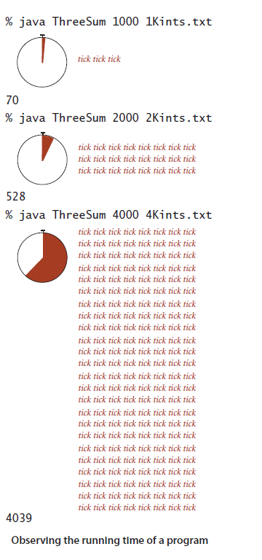
Measuring the running time
Q. How to time a program?
A. Manual.

Slide 13
Empirical analysis
Run the program for various input sizes and measure running time.
N | time (seconds) †
250 | 0
500 | 0
1,000 | 0.1
2,000 | 0.8
4,000 | 6.4
8,000 | 51.1
16,000 | ?
Notes:
These timings are on a faster computer.

Slide 14
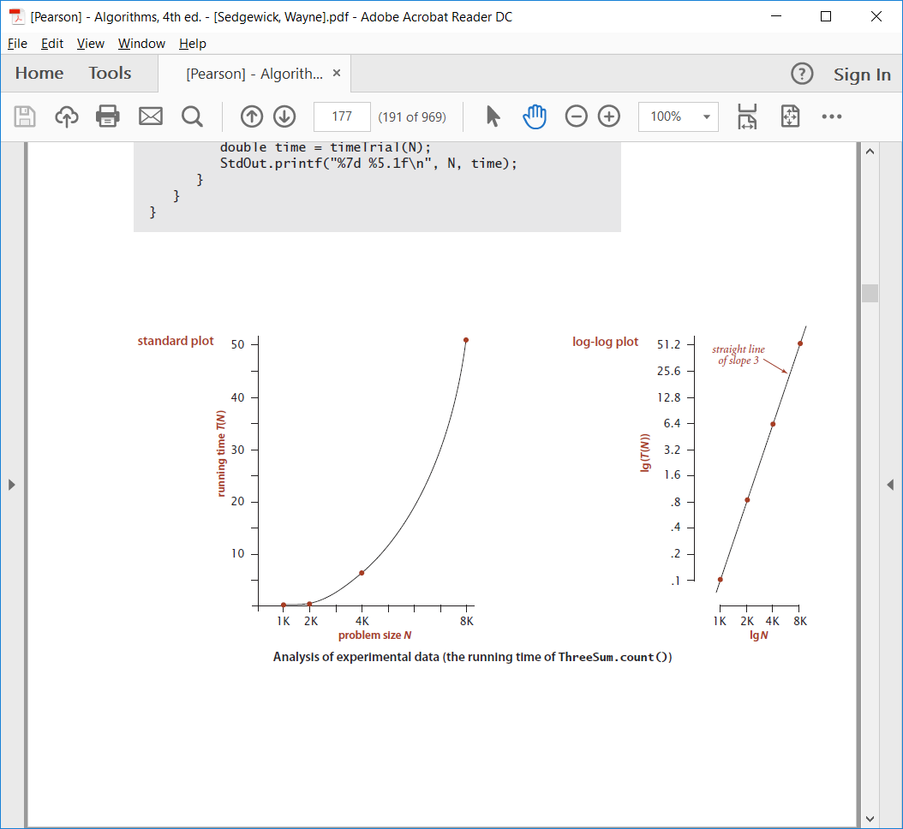
Data analysis
Standard plot. Plot running time T (N) vs. input size N.

Slide 15
Data analysis
Log-log plot. Plot running time T (N) vs. input size N using log-log scale.
Regression. Fit straight line through data points: a N ^{b}.
Hypothesis. The running time is about 1.006 ⋅ 10 ^{–10} ⋅ N ^{2.999} seconds.
lg(T (N)) = b lg N + c
b = 2.999
c = -33.2103
T (N) = a N ^{b}, where a = 2 ^{c}
3 orders
of magnitude
power law
slope
Notes:
log-log plot identifies power law relationships
technically, we shouldn't really run a linear regression on log-log scale - it's not statistically valid.

Slide 16
Prediction and validation
Hypothesis. The running time is about 1.006 ⋅ 10 ^{–10} ⋅ N ^{2.999} seconds.
Predictions.
51.0 seconds for N = 8,000.
408.1 seconds for N = 16,000.
Observations.
"order of growth" of running time is about N³ [stay tuned]
N | time (seconds) †
8,000 | 51.1
8,000 | 51
8,000 | 51.1
16,000 | 410.8
validates hypothesis!
Notes:
lg(T(N)) = 2.9992 lg N - 33.2103, correlation coefficient = 1.0
Very accurate predictions.
2x input size -> 8x increase in running time for cubic algorithm

Slide 17
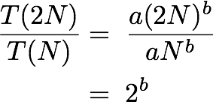
Doubling hypothesis
Doubling hypothesis. Quick way to estimate b in a power-law relationship.
Run program, doubling the size of the input.
Hypothesis. Running time is about a N ^{b} with b = lg ratio.
Caveat. Cannot identify logarithmic factors with doubling hypothesis.
N | time (seconds) † | ratio | lg ratio
250 | 0 |  | –
500 | 0 | 4.8 | 2.3
1,000 | 0.1 | 6.9 | 2.8
2,000 | 0.8 | 7.7 | 2.9
4,000 | 6.4 | 8 | 3
8,000 | 51.1 | 8 | 3
lg (6.4 / 0.8) = 3.0
seems to converge to a constant b ≈ 3
Notes:
put more emphasis on ratios with larger N since lots of noise contained in data for smaller N
do calculation T(2N) / T(N) = a(2N)^b / aN^b = 2^b on blackboard, whereT(N) = a N^b. Then take binary lg of both sides to get T(2N) / T(N) = b.

Slide 18
Doubling hypothesis
Doubling hypothesis. Quick way to estimate b in a power-law relationship.
Q. How to estimate a (assuming we know b) ?
A. Run the program (for a sufficient large value of N) and solve for a.
Hypothesis. Running time is about 0.998 ⋅ 10 ^{–10} ⋅ N ³ seconds.
N | time (seconds) †
8,000 | 51.1
8,000 | 51
8,000 | 51.1
51.1 = a ⋅ 8000³
⇒ a = 0.998 ⋅ 10 ^{–10}
almost identical hypothesis
to one obtained via linear regression

Slide 19
Experimental algorithmics
System independent effects.
Algorithm.
Input data.
System dependent effects.
Hardware: CPU, memory, cache, …
Software: compiler, interpreter, garbage collector, …
System: operating system, network, other apps, …
Bad news. Difficult to get precise measurements. Good news. Much easier and cheaper than other sciences.
determines exponent
in power law
determines constant in power law
e.g., can run huge number of experiments
Notes:
CPU use by other applications: if connected to Internet, some hacker is using your computer to send spam, steal your money, etc.
Good news: compared to other scientists, running computational experiments is easy. Don't need to kill cows, blow up islands.

Slide 20
Mathematical Models

Slide 21
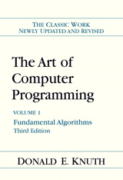
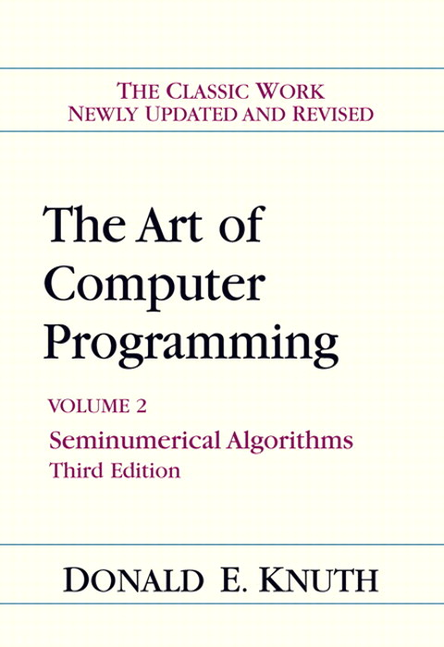
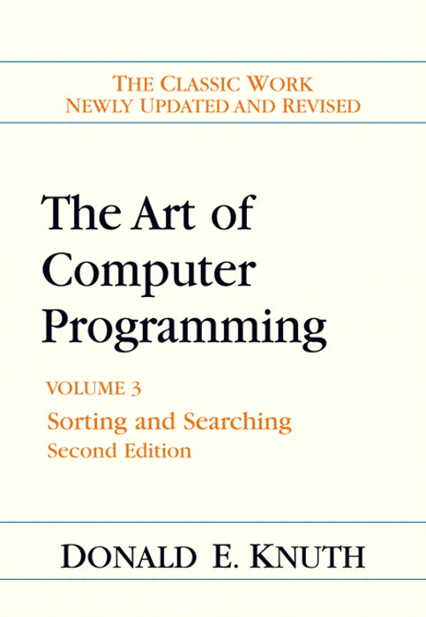
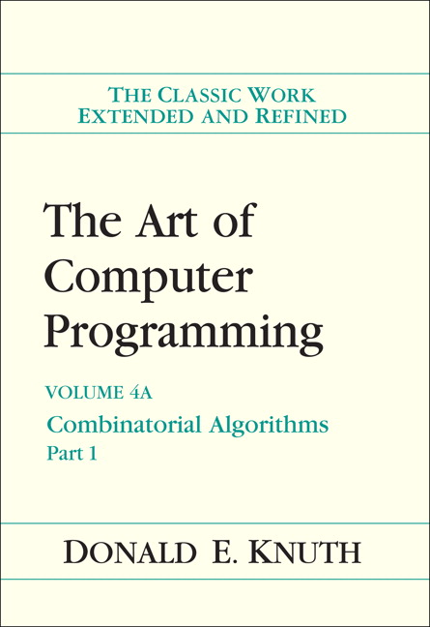
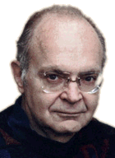
Mathematical models for running time
Total running time: sum of cost ⋅ frequency for all operations.
Need to analyze program to determine set of operations.
Cost depends on machine, compiler.
Frequency depends on algorithm, input data.
In principle, accurate mathematical models are available.
Donald Knuth 1974 Turing Award
Notes:
most famous modeling by Knuth - detailed results to accurate predict running time
Knuth's idea seems obvious in hindsight, but in the 1960s, programmers said it would never be possible to analyze the running time of a computer program since they are too complicated. Knuth's TAOCP is now a classic treatise on the subject.

Slide 22
Cost of basic operations
Challenge. How to estimate constants.
operation | example | nanoseconds †
integer add | a + b | 2.1
integer multiply | a * b | 2.4
integer divide | a / b | 5.4
floating-point add | a + b | 4.6
floating-point multiply | a * b | 4.2
floating-point divide | a / b | 13.5
sine | Math.sin(theta) | 91.3
arctangent | Math.atan2(y, x) | 129
... | ... | ...
† Running OS X on Macbook Pro 2.2GHz with 2GB RAM
Notes:
trig and exponential ops more expensive that integer ops

Slide 23
Cost of basic operations
Observation. Most primitive operations take constant time.
Caveat. Non-primitive operations often take more than constant time.
operation | example | nanoseconds †
variable declaration | int a | c1
assignment statement | a = b | c2
integer compare | a < b | c3
array element access | a[i] | c4
array length | a.length | c5
1D array allocation | new int[N] | c6 N
2D array allocation | new int[N][N] | c7 N ²
novice mistake: abusive string concatenation

Slide 24
Example: 1-Sum
Q. How many instructions as a function of input size N ?
int count = 0;
for (int i = 0; i < N; i++)
if (a[i] == 0)
count++;
N array accesses
operation | frequency
variable declaration | 2
assignment statement | 2
less than compare | N + 1
equal to compare | N
array access | N
increment | N to 2 N
Notes:
that's the cost of each operation; more interestingly is the frequency of each operation
walk through frequency count for array accesses
consider putting in instruction counts for N = 10000
increment: between N (no zeros) and 2N (all zeros)

Slide 25
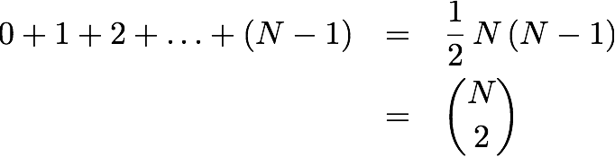

Example: 2-Sum
Q. How many instructions as a function of input size N ?
Pf. [ n even]
int count = 0;
for (int i = 0; i < N; i++)
for (int j = i+1; j < N; j++)
if (a[i] + a[j] == 0)
count++;
half of square
half of diagonal
Notes:
walk through frequency count for array accesses
on blackboard, show sum 0 + 1 + 2 + … + (N-3) + (N-2) + (N-1). Pair terms 0 and N-1, 1 and N-2, and so on. Each term averages (N-1)/2 and there are N/2 of them if N is even.
0 + 1 + 2 + \ldots + (N-1) \; = \; \frac{1}{2} N^2 \;-\; \frac{1}{2} N

Slide 26
Example: 2-Sum
Q. How many instructions as a function of input size N ?
int count = 0;
for (int i = 0; i < N; i++)
for (int j = i+1; j < N; j++)
if (a[i] + a[j] == 0)
count++;
operation | frequency
variable declaration | N + 2
assignment statement | N + 2
less than compare | ½ (N + 1) (N + 2)
equal to compare | ½ N (N − 1)
array access | N (N − 1)
increment | ½ N (N − 1) to N (N − 1)
tedious to count exactly
Notes:
N(N-1) instead of ½ N(N-1) because there are two array accesss per inner loop

Slide 27
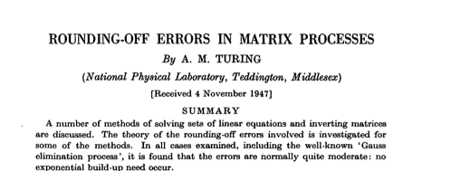
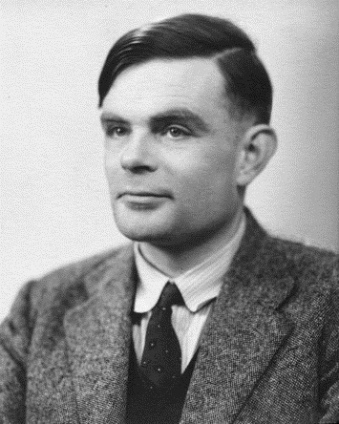
Simplifying the calculations
“ It is convenient to have a measure of the amount of work involved
in a computing process, even though it be a very crude one. We may count up the number of times that various elementary operations are
applied in the whole process and then given them various weights.
We might, for instance, count the number of additions, subtractions,
multiplications, divisions, recording of numbers, and extractions
of figures from tables. In the case of computing with matrices most
of the work consists of multiplications and writing down numbers,
and we shall therefore only attempt to count the number of
multiplications and recordings. ” — Alan Turing
Notes:
The idea that we measure only the number of fundamental operations is a classical notion that dates back at least to Turing.
Rounding-off errors in matrix processing. A. M. Turing, QJ Mechanics Appl Math (1948)

Slide 28
Simplification 1: cost model
Cost model. Use some basic operation as a proxy for running time.
int count = 0;
for (int i = 0; i < N; i++)
for (int j = i+1; j < N; j++)
if (a[i] + a[j] == 0)
count++;
operation | frequency
variable declaration | N + 2
assignment statement | N + 2
less than compare | ½ (N + 1) (N + 2)
equal to compare | ½ N (N − 1)
array access | N (N − 1)
increment | ½ N (N − 1) to N (N − 1)
cost model = array accesses
(we assume compiler/JVM do not optimize any array accesses away!)
Notes:
arithmetic operations would also be a reasonable cost model
Ex 2. Cost model for union-find = array accesses.
Ex 3. Cost model for sorting = compares.

Slide 29
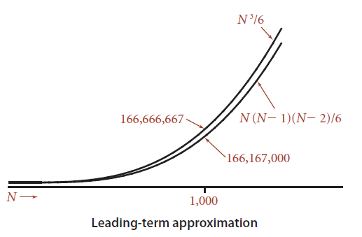
Simplification 2: tilde notation
Estimate running time (or memory) as a function of input size N.
Ignore lower order terms.
when N is large, terms are negligible
when N is small, we don't care
Ex 1. ⅙ N ³ + 20 N + 16 ~ ⅙ N ³
Ex 2. ⅙ N ³ + 100 N ^{4/3} + 56 ~ ⅙ N ³
Ex 3. ⅙ N ³ − ½ N ² + ⅓ N ~ ⅙ N ³
Technical definition. f(N) ~ g(N) means
discard lower-order terms (e.g., N = 1000: 166.67 million vs. 166.17 million)
Notes:
lower order term is 500,000

Slide 30
Simplification 2: tilde notation
Estimate running time (or memory) as a function of input size N.
Ignore lower order terms.
when N is large, terms are negligible
when N is small, we don't care
operation | frequency | tilde notation
variable declaration | N + 2 | ~ N
assignment statement | N + 2 | ~ N
less than compare | ½ (N + 1) (N + 2) | ~ ½ N ²
equal to compare | ½ N (N − 1) | ~ ½ N ²
array access | N (N − 1) | ~ N ²
increment | ½ N (N − 1) to N (N − 1) | ~ ½ N ² to ~ N ²

Slide 31
Example: 2-Sum
Q. Approximately how many array accesses as a function of input size N ?
A. ~ N ² array accesses.
Bottom line. Use cost model and tilde notation to simplify counts.
int count = 0;
for (int i = 0; i < N; i++)
for (int j = i+1; j < N; j++)
if (a[i] + a[j] == 0)
count++;
"inner loop"

Slide 32
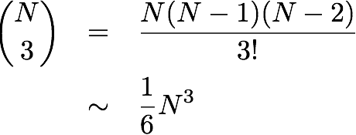
Example: 3-Sum
Q. Approximately how many array accesses as a function of input size N ?
A. ~ ½ N ³ array accesses.
Bottom line. Use cost model and tilde notation to simplify counts.
int count = 0;
for (int i = 0; i < N; i++)
for (int j = i+1; j < N; j++)
for (int k = j+1; k < N; k++)
if (a[i] + a[j] + a[k] == 0)
count++;
"inner loop"
Notes:
N^3 / 6 arises because N choose 3 is the number of triples i, j, k
½ N^3 because there are three array accesses in the inner loop

Slide 33
Mathematical models for running time
In principle, accurate mathematical models are available.
In practice,
Formulas can be complicated.
Advanced mathematics might be required.
Exact models best left for experts.
Bottom line. We use approximate models in this course: T(N) ∼ c N ³.
costs (depend on machine, compiler)
TN = c1 A + c2 B + c3 C + c4 D + c5 E
A = array access
B = integer add
C = integer compare
D = increment
E = variable assignment
frequencies
(depend on algorithm, input)

Slide 34
Order-of-growth classifications

Slide 35
Common order-of-growth classifications
Definition. If f (N) ~ c g(N) for some constant c > 0, then the order of growth of f (N) is g(N).
Ignores leading coefficient.
Ignores lower-order terms.
Ex. The order of growth of the running time of this code is N ³.
Typical usage. With running times.
int count = 0;
for (int i = 0; i < N; i++)
for (int j = i+1; j < N; j++)
for (int k = j+1; k < N; k++)
if (a[i] + a[j] + a[k] == 0)
count++;
where leading coefficient
depends on machine, compiler, JVM, ...

Slide 36
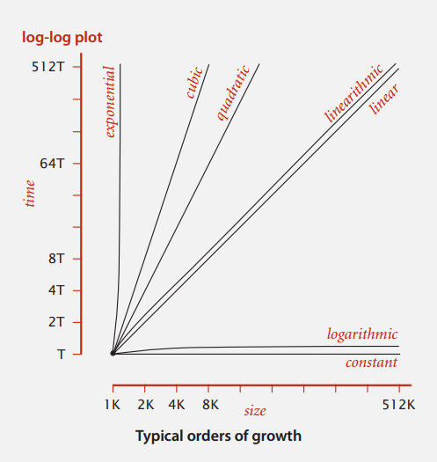
Common order-of-growth classifications
Good news. The set of functions 1, log N, N, N log N, N ², N ³, and 2^{N}
suffices to describe the order of growth of most common algorithms.
Notes:
reason: programs are comprised of just a few structural primitives: statements, loops, conditionals, nesting, function calls

Slide 37
Common order-of-growth classifications
order of growth | name | typical code framework | description | example | T(2N) / T(N)
1 | constant | a = b + c; | statement | add two numbers | 1
log N | logarithmic | while (N > 1) { N = N / 2; ... } | divide in half | binary search | ~ 1
N | linear | for (int i = 0; i < N; i++) { ... } | loop | find the maximum | 2
N log N | linearithmic | [see mergesort lecture] | divide and conquer | mergesort | ~ 2
N ² | quadratic | for (int i = 0; i < N; i++) for (int j = 0; j < N; j++) { ... } | double loop | check all pairs | 4
N ³ | cubic | for (int i = 0; i < N; i++) for (int j = 0; j < N; j++) for (int k = 0; k < N; k++) { ... } | triple loop | check all triples | 8
2^{N} | exponential | [see combinatorial search lecture] | exhaustive search | check all subsets | T(N)
Notes:
this partially explains reason why small set of functions
arises from straightforward composition of loops, conditionals, functions
T(2N) / T(N) is factor for doubling hypothesis

Slide 38
Practical implications of order-of-growth
Bottom line. Need linear or linearithmic alg to keep pace with Moore's law.
growth rate | problem size solvable in minutes
 | 1970s | 1980s | 1990s | 2000s
1 | any | any | any | any
log N | any | any | any | any
N | millions | tens of millions | hundreds of millions | billions
N log N | hundreds of thousands | millions | millions | hundreds of millions
N² | hundreds | thousand | thousands | tens of thousands
N³ | hundred | hundreds | thousand | thousands
2^{N} | 20 | 20s | 20s | 30

Slide 39
Practical implications of order-of-growth
growth rate | problem size solvable in minutes |  |  |  | time to process millions of inputs
 | 1970s | 1980s | 1990s | 2000s | 1970s | 1980s | 1990s | 2000s
1 | any | any | any | any | instant | instant | instant | instant
log N | any | any | any | any | instant | instant | instant | instant
N | millions | tens of millions | hundreds of millions | billions | minutes | seconds | second | instant
N log N | hundreds of thousands | millions | millions | hundreds of millions | hour | minutes | tens of seconds | seconds
N² | hundreds | thousand | thousands | tens of thousands | decades | years | months | weeks
N³ | hundred | hundreds | thousand | thousands | never | never | never | millennia

Slide 40
Practical implications of order-of-growth
growth rate | name | description | effect on a program that runs for a few seconds
 |  |  | time for 100x more data | size for 100x faster computer
1 | constant | independent of input size | – | –
log N | logarithmic | nearly independent of input size | – | –
N | linear | optimal for N inputs | a few minutes | 100x
N log N | linearithmic | nearly optimal for N inputs | a few minutes | 100x
N² | quadratic | not practical for large problems | several hours | 10x
N³ | cubic | not practical for medium problems | several weeks | 4–5x
2^{N} | exponential | useful only for tiny problems | forever | 1x

Slide 41

Binary search demo
Goal. Given a sorted array and a key, find index of the key in the array?
Binary search. Compare key against middle entry.
Too small, go left.
Too big, go right.
Equal, found.
successful search for 33
6 | 13 | 14 | 25 | 33 | 43 | 51 | 53 | 64 | 72 | 84 | 93 | 95 | 96 | 97
0 | 1 | 2 | 3 | 4 | 5 | 6 | 7 | 8 | 9 | 10 | 11 | 12 | 13 | 14
lo
hi
Notes:
Ex. Dictionary, phone book, book index, …
Binary search algorithm: Examine the middle key; If it matches, return its index; Otherwise, search either the left or right half.

Slide 42
Binary search: Java implementation
Trivial to implement?
First binary search published in 1946.
First bug-free one in 1962.
Bug in Java's Arrays.binarySearch() discovered in 2006.
Invariant. If key appears in the array a[], then a[lo] ≤ key ≤ a[hi].
public static int binarySearch(int[] a, int key)
{
int lo = 0, hi = a.length-1;
while (lo <= hi)
{
int mid = lo + (hi - lo) / 2;
if (key < a[mid]) hi = mid - 1;
else if (key > a[mid]) lo = mid + 1;
else return mid;
}
return -1;
}
one "3-way compare"
Notes:
Simple algorithm but notorious to get details exactly right. Indication of care we need to take to develop libraries that will be used by millions of programmers.
Easy to convince ourselves that the program works as advertised by considering the invariant.
Q. Why lo + (hi - lo) / 2 instead of (lo + hi) / 2 ?
A. Avoid overflow.
Q. What was bug in Java 1.5?
A. mid = (lo + hi) >> 1 instead of (lo + hi) >>> 1. Former susceptible to int overflow for very large arrays.

Slide 43
Binary search: mathematical analysis
Proposition. Binary search uses at most 1 + lg N key compares to search in a sorted array of size N.
Def. T (N) = # key compares to binary search a sorted subarray of size ≤ N.
Binary search recurrence. T (N) ≤ T (N / 2) + 1 for N > 1, with T (1) = 1.
Pf sketch. [assume N is a power of 2]
left or right half
(floored division)
possible to implement with one
2-way compare (instead of 3-way)
T (N) | ≤ | T (N / 2) + 1 | [ given ]
 | ≤ | T (N / 4) + 1 + 1 | [ apply recurrence to first term ]
 | ≤ | T (N / 8) + 1 + 1 + 1 | [ apply recurrence to first term ]
 | ⋮
 | ≤ | T (N / N) + 1 + 1 + … + 1 | [ stop applying, T(1) = 1 ]
 | = | 1 + lg N
Notes:
We count 3-way compares
Here N/2 means integer division, i.e., floor(N/2)
slight cheat because N is not always a power of two
possible to implement with one 2-way compare (instead of 3-way) by deferring equality check until subarray size is 1

Slide 44
Binary search: mathematical analysis
Proposition. Binary search uses at most 1 + lg N key compares to search in a sorted array of size N.
Def. T (N) ≡ # key compares to binary search a sorted subarray of size ≤ N.
Binary search recurrence. T (N) ≤ T (⎣N / 2⎦) + 1 for N > 1, with T (0) = 0.
For simplicity, we prove when N = 2^{n} − 1 for some n, so ⎣N / 2⎦ = 2^{n−1} − 1.
T (2^{n} − 1) ≤ T (2^{n−1} − 1) + 1 ≤ T (2^{n−2} − 1) + 1 + 1
≤ T (2^{n−3} − 1) + 1 + 1 + 1
. . .
≤ T (2⁰ − 1) + 1 + 1 + … + 1
= n
given
apply recurrence to first term
apply recurrence to first term
stop applying, T(0) = 1
Notes:
We consider one compare key vs. a[mid]
By assuming N is one less than a power of two, we ensure the size of each subarray is also one less than a power of two

Slide 45
An N² log N algorithm for 3-Sum
Algorithm.
Step 1: Sort the N (distinct) numbers.
Step 2: For each pair of numbers a[i] and a[j], binary search for -(a[i] + a[j]).
Analysis. Order of growth is N ² log N.
Step 1: N ² with insertion sort.
Step 2: N ² log N with binary search.
Remark. Can achieve N ² by modifying binary search step.
input
30 -40 -20 -10 40 0 10 5
sort
-40 -20 -10 0 5 10 30 40
binary search
(-40, -20) 60
(-40, -10) 50
(-40, 0) 40
(-40, 5) 35
(-40, 10) 30
⋮ ⋮
(-20, -10) 30
⋮ ⋮
(-10, 0) 10
⋮ ⋮
( 10, 30) -40
( 10, 40) -50
( 30, 40) -70
only count if
a[i] < a[j] < a[k]
to avoid
double counting
Notes:
Note: we insist upon the N numbers to be distinct; otherwise, there are more corner cases to deal with.
Instead of only counting if a[i] < a[j] < a[k], could binary search in subarray a[j+1..N-1]

Slide 46
Comparing programs
Hypothesis. The sorting-based N ² log N algorithm for 3-Sum is significantly faster in practice than the brute-force N ³ algorithm.
Guiding principle. Typically, better order of growth ⇒ faster in practice.
N | time (seconds)
1,000 | 0.1
2,000 | 0.8
4,000 | 6.4
8,000 | 51.1
N | time (seconds)
1,000 | 0.14
2,000 | 0.18
4,000 | 0.34
8,000 | 0.96
16,000 | 3.67
32,000 | 14.88
64,000 | 59.16
ThreeSum.java
ThreeSumDeluxe.java

Slide 47
Theory of algorithms

Slide 48
Types of analyses
Best case. Lower bound on cost.
Determined by “easiest” input.
Provides a goal for all inputs.
Worst case. Upper bound on cost.
Determined by “most difficult” input.
Provides a guarantee for all inputs.
Average case. Expected cost for random input.
Need a model for “random” input.
Provides a way to predict performance.
this course
Ex 1. Array accesses for brute-force 3-Sum. Best: ∼ ½ N ³
Average: ∼ ½ N ³
Worst: ∼ ½ N ³
Ex 2. Compares for binary search.
Best: ∼ 1
Average: ∼ lg N
Worst: ∼ lg N

Slide 49
Theory of algorithms
Goals.
Establish “difficulty” of a problem.
Develop “optimal” algorithms.
Approach.
Suppress details in analysis: analyze “to within a constant factor.”
Eliminate variability in input model: focus on the worst case.
Upper bound. Performance guarantee of algorithm for any input.
Lower bound. Proof that no algorithm can do better.
Optimal algorithm. Lower bound = upper bound (to within a constant factor).

Slide 50
Commonly-used notations in the theory of algorithms
notation | provides | example | shorthand for | used to
Big Theta | asymptotic order of growth | Θ(N²) | ½ N ² 10 N ² 5 N ² + 22 N log N + 3N ⋮ | classify algorithms
Big Oh | Θ(N²) and smaller | O(N²) | 10 N ² 100 N 22 N log N + 3 N ⋮ | develop upper bounds
Big Omega | Θ(N²) and larger | Ω(N²) | ½ N ² N ⁵ N ³ + 22 N log N + 3 N ⋮ | develop lower bounds

Slide 51
Algorithm design approach
Start.
Develop an algorithm.
Prove a lower bound.
Gap?
Lower the upper bound (discover a new algorithm).
Raise the lower bound (more difficult).
Golden Age of Algorithm Design.
1970s‑.
Steadily decreasing upper bounds for many important problems.
Many known optimal algorithms.
Caveats.
Overly pessimistic to focus on worst case?
Need better than “to within a constant factor” to predict performance.

Slide 52
Commonly-used notations in the theory of algorithms
Common mistake. Interpreting big-Oh as an approximate model.
notation | provides | example | shorthand for | used to
Tilde | leading term | ~ 10 N ² | 10 N ² 10 N ² + 22 N log N 10 N ² + 2 N + 37 | provide approximate model
Big Theta | asymptotic order of growth | Θ(N²) | ½ N ² 10 N ² 5 N ² + 22 N log N + 3N | classify algorithms
Big Oh | Θ(N²) and smaller | O(N²) | 10 N ² 100 N 22 N log N + 3 N | develop upper bounds
Big Omega | Θ(N²) and larger | Ω(N²) | ½ N ² N ⁵ N ³ + 22 N log N + 3 N | develop lower bounds

